Slide 1





Advanced
FortiGate
Security
Profiles
Prepared by :
1- Ebrahim Sabry Farouk
2-Hussein Hisham Hussein
3- Ahmed Samy Abdallah Shokr
4-Mohamed Rabia fathi
5-Ahmed maged mohamed
6-Bishoy remon fahmy
Instructor Name : Eng. El Hosein Ahmed

Slide 2


Project Overview
This project focuses on designing and implementing a fully secured enterprise network infrastructure.
The goal is to build a scalable multi-VLAN network with redundancy, security, dynamic routing, and integration with FortiGate firewalls.

Slide 3
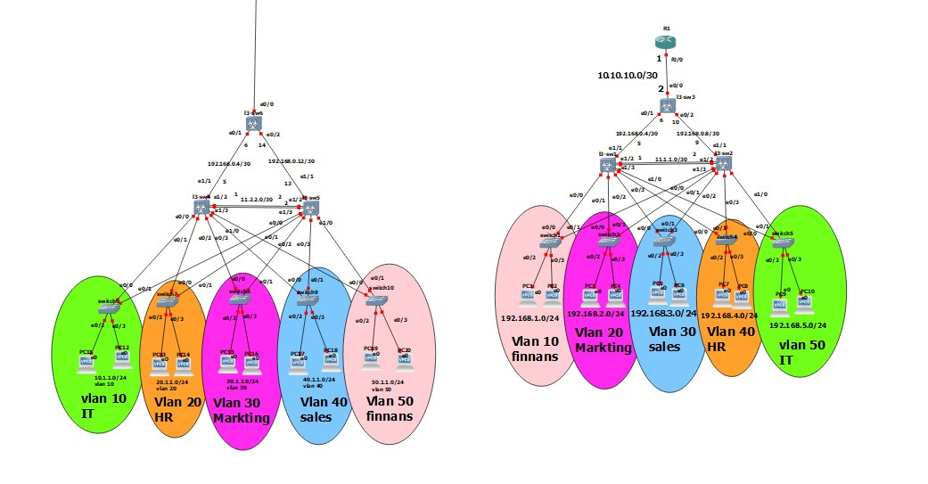
Network Architecture Model
The network follows a hierarchical enterprise model:
Core Layer
Distribution Layer (DSW-1 & DSW-2)
Access Layer (Finance, Marketing, Sales, HR, IT)

Slide 4

Structure
VLAN
The network contains five main VLANs:
VLAN 10 – Finance – 192.168.1.0/24
VLAN 20 – Marketing – 192.168.2.0/24
VLAN 30 – Sales – 192.168.3.0/24
VLAN 40 – HR – 192.168.4.0/24
VLAN 50 – IT – 192.168.5.0/24

Slide 5

Configuration
SVI
SVIs configured on distribution switches:
DSW-1:
VLAN 10 → 192.168.1.254
VLAN 20 → 192.168.2.254
VLAN 30 → 192.168.3.254
VLAN 40 → 192.168.4.254
VLAN 50 → 192.168.5.254
DSW-2: Uses .253 as backup gateway for all VLANs.

Slide 6

VTP Configuration
VTP Domain: cisco.com
Password: 123
DSW-1: Server Mode
DSW-2: Server Mode
Access Switches: Client Mode

Slide 7

Trunking & DTP
All uplinks configured as 802.1Q trunks
Allowed VLANs: 10, 20, 30, 40, 50
Native VLAN: 100
DSWs: Dynamic Desirable
Access Switches: Dynamic Auto

Slide 8

Port Security
Applied on access-layer user ports:
Max 2 MAC addresses
Sticky MAC enabled
Violation mode: Restrict
PortFast enabled for end-user ports

Slide 9
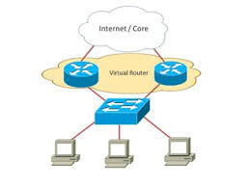
(HSRP + STP)
Redundancy
HSRP:
Virtual Gateway: 192.168.x.100
DSW-1 active for VLANs 10,20,30
DSW-2 active for VLANs 40,50
STP:
Priorities tuned to match HSRP roles for optimal traffic flow

Slide 10
EtherChannel
Layer-3 EtherChannel between DSW-1 & DSW-2:
Port-Channel 10
DSW-1: 11.1.1.1/30
DSW-2: 11.1.1.2/30
Mode: ON

Slide 11
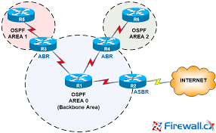
OSPF Dynamic Routing
OSPF Area: 0
Runs on Core & Distribution switches
SVIs are passive
Advertises:
All VLAN networks
Inter-switch links

Slide 12


FortiGate

Slide 13
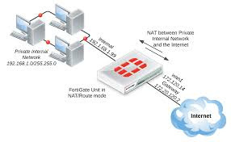
FortiGate Interface
Configuration
Three main interfaces:
LAN Interface: connected to core switch
WAN Interface: provides Internet access
Management Interface: secure admin access only

Slide 14
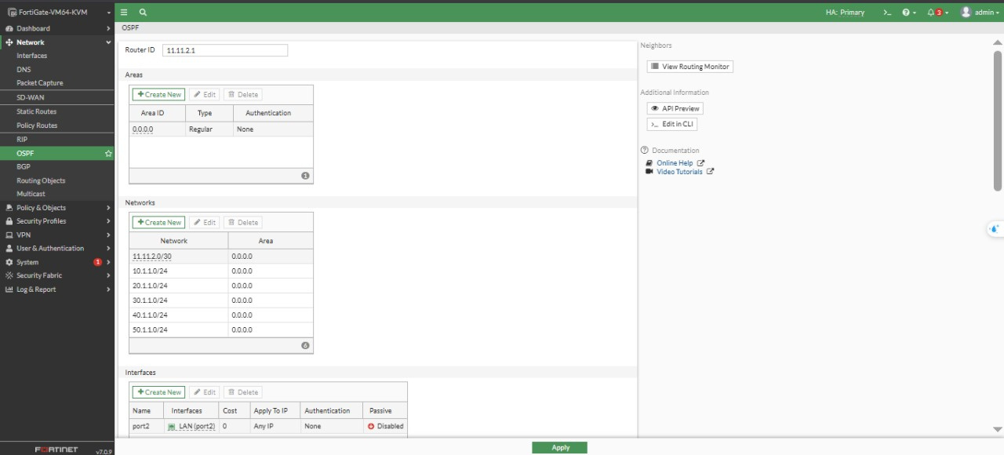
OSPF Dynamic VLAN
Learning
OSPF enabled on the FortiGate
Firewall learns all VLANs dynamically from Core switch
Reduces manual configuration
Improves scalability

Slide 15
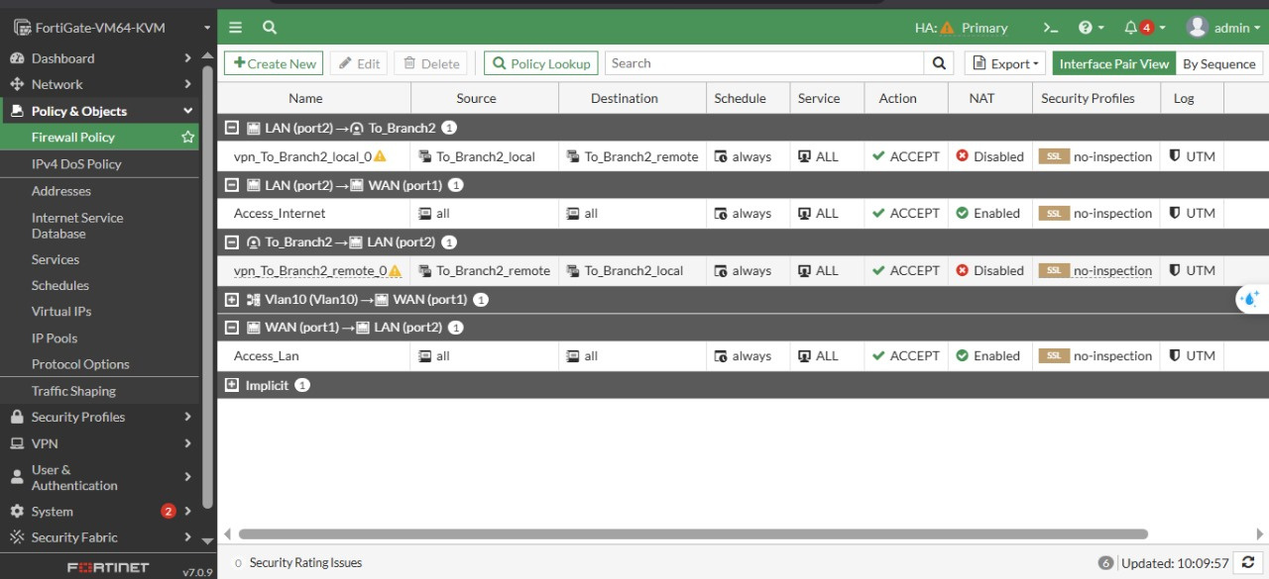
Firewall
Policies
1. LAN → WAN Policy:
Allows internal users to access Internet
NAT enabled
2. WAN → LAN Policy:
Allows external access to published internal services
Secured by filtering profiles

Slide 16

Security Profiles Applied
Antivirus:
Applied on inbound WAN → LAN traffic
Protects against malware/viruses
Web Filter:
Applied on LAN → WAN
Blocks harmful & non-business websites
Application Control:
Blocks social media and productivity-reducing apps

Slide 17
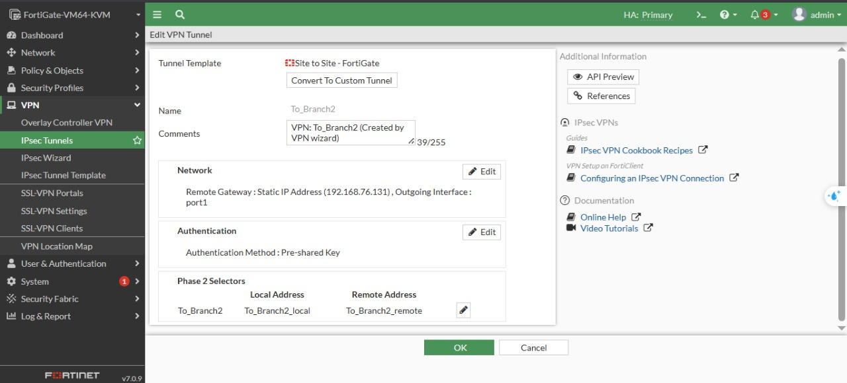
Connectivity
IPsec VPN
A site-to-site VPN tunnel was configured:
Phase 1 & Phase 2 completed
Tunnel up and stable
Routing configured between sites
Specific VPN policy created

Slide 18

Routing on FortiGate
Default Route: 0.0.0.0/0 → WAN gateway
Inter-branch routing via:
Static routes or
OSPF through the VPN tunnel

Slide 19
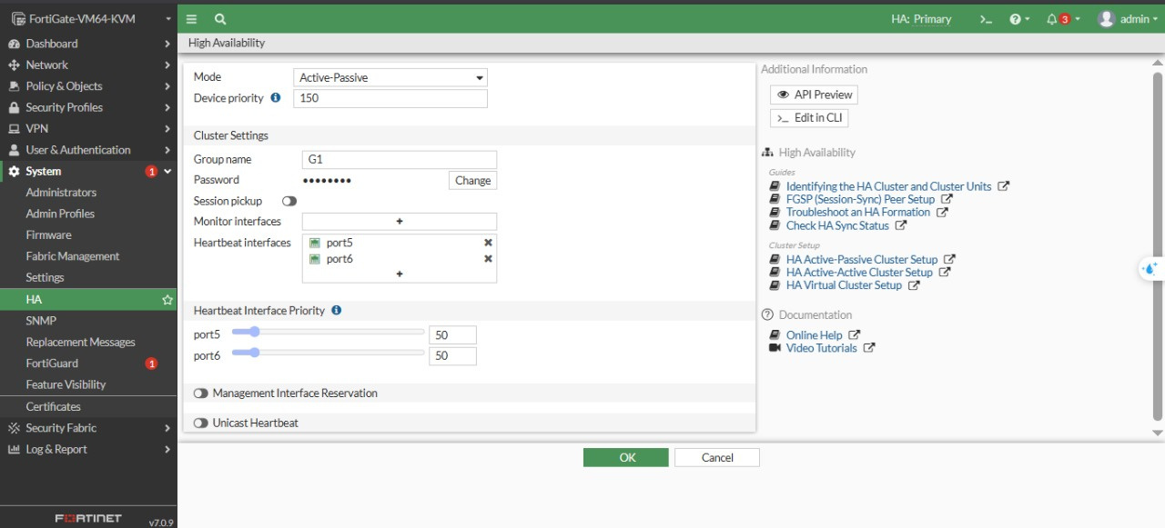
High Availability (HA)
Active–Passive HA configuration
Automatic failover
Ensures high uptime and business continuity

Slide 20

Full Network Integration
The FortiGate firewall integrates fully with the Cisco-based network:
Learns VLANs dynamically via OSPF
Secures all inbound & outbound traffic
Provides VPN connectivity
Works with enterprise VLAN segmentation
Enhances reliability via HA

Slide 21
Conclusion
This combined Cisco + FortiGate design delivers:
High security
Full redundancy
Scalable multi-VLAN architecture
Branch connectivity
Enterprise-grade protection
The network is ready for expansion and advanced security enhancements.

Slide 22
Thank you for your attention!

